Slide 1


Agenda of in-Person Session
 Tour in the BCTI Building Center.
 Review ands questions about the previous lesson.
 Questions about Lab and discussion.
 Determining Data Center Capacities.
 Determining Criteria for Rack Location Units.
 Summarizing the lesson.
 Topic of the next lesson.

Slide 2
Determining Data Center Capacities
 Data Center Capacities.
 Purpose of Rack Location Units.
 Data Center Evolution.
25
 Determining Criteria for RLUs (Rack Location Units).

Slide 3
Data Center Capacities
The design of the data center is dependent on the balance of two sets of capacities:
 Data center capacities: Power, cooling, physical space, weight load, bandwidth (or connectivity), and functional capacities.
26
 Equipment capacities: The various devices (typically equipment in racks) that could populate the data center in various numbers
Depending on the chosen site of the data center, one of these sets of capacities will usually determine the other. For example, if the project scope includes a preferred amount of equipment capacity for the data center, the knowledge of the equipment requirements can be used to determine the size of the center, the amount of power and cooling needed, the weight load rating of the raised floor, and the cabling needed for connectivity to the network.

Slide 4

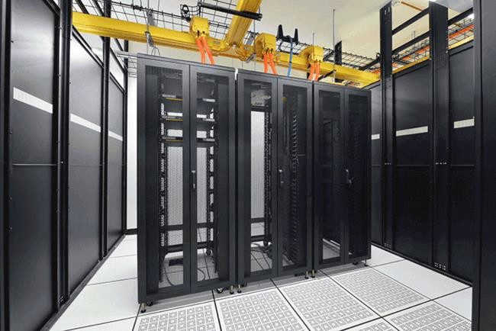
Purpose of Rack Location Units
 The Rack Location Unit (RLU) system is a completely flexible and scalable system that can be used to determine the equipment needs for a data center of any size, whether 100 or 100,000,000 square feet. The system can be used whether you are designing a data center that will be built to suit, or using a predefined space.
 The RLU determinations are a task of the design process and can determine whether or not the space is adequate to fulfill the company requirements. Regardless of limiting factors, RLUs allow you the flexibility to design within them.
31

Slide 5
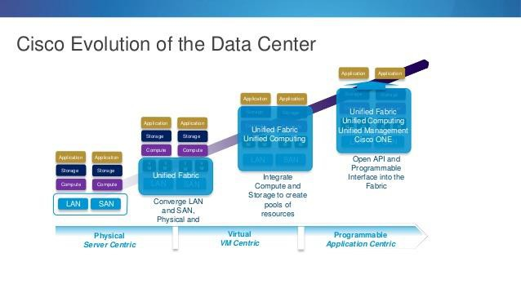
Data Center Evolution
 In the past, there were mainframes. There was usually only one of them for a company or a data center.
 Nowadays , Computers have become a lot faster and a lot smaller. The data center that used to house just one machine now holds tens, hundreds, perhaps thousands of machines and you have different types of servers, storage arrays, and network equipment, typically contained in racks.
28

Slide 6
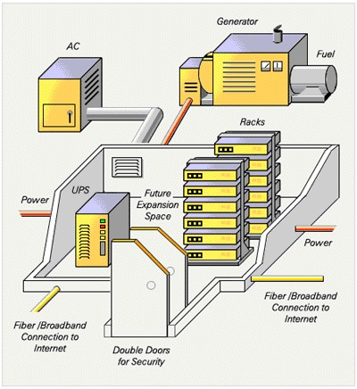
Determining Criteria for RLUs
we should examine the six criteria used in the determinations:
Power (how many outlets/circuits it requires, how many watts it draws)
Cooling (BTUs per hour that must be cooled)BTU: British thermal unit
Physical space (how much floor space each rack needs, including the cooling dimensions)
Weight (how much a rack weighs)
Bandwidth (how it connects to the network)
Functional capacity (how much computational power, physical memory, disk space, as well as how many spindles, MFLOPS, database transactions, and any other measures of rack functions)
29

Slide 7

Power
You need to know the following:
What is needed to plug in the rack
The outlet type
 Its voltage and amperage
Whether it’s single phase or three phase
How much power the rack will draw
The last item is best described in watts. This information should be part of the manufacturer’s specifications. However, if the
specifications don’t tell you how many watts the device will draw, you can calculate this from the BTUs-per-hour rating of the
rack.
BTUs per hour 3.42 = watts
30

Slide 8

Cooling
31
Cooling requirements are specified as BTUs per hour. This should be part of the manufacturer’s specifications. If it is not, you can calculate it from the amount of watts the machine uses.
Watts X 3.42 = BTUs per hour
At minimum, either BTUs per hour or watt usage must be available from the HVAC manufacturer. The requirement is to deliver enough conditioned air to the rack to meet the BTUs per hour requirement

Slide 9
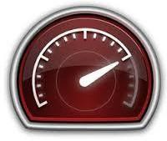
Bandwidth
32
The primary concern with bandwidth (connectivity) is the network and storage cabling within the data center. When determining the bandwidth part of the RLU, the concern will primarily be whether or not there are enough connections for the rack to interface with other devices.
To effectively plan connectivity outside the data center, your ISP service bandwidth should meet or exceed the total capacity of your data center’s inbound and outbound bandwidth specifications.

Slide 10

Weight
33
It is critical that you know not only the individual weights of each type of rack that will reside in the data center, but the combined weight of all of them.
With this knowledge, and some forethought as to the future weight that will be added, you can decide whether the existing floor can handle the load. Or, if you are building to suit, you can plan for a subfloor and raised floor that will exceed the weight demands. There are a few different floor load capacities to consider:
Total floor load
Total tile load
Point load of tile

Slide 11
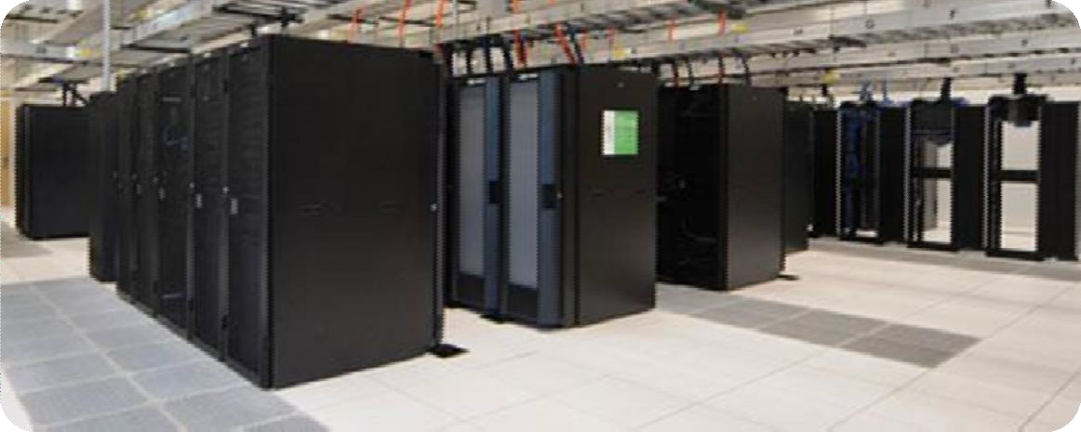
Physical Space
34
The width and depth dimensions of the rack.
The cooling dimensions of the rack (the physical dimensions plus the extra space needed for intake and exhaust of air as defined by the rack cooling profile). Cooling dimensions are described in the previous “Cooling” section.
The free space needed for aisles, row breaks, ramps, and free air
circulation (typically 40 to 50 percent of the total square footage).

Slide 12
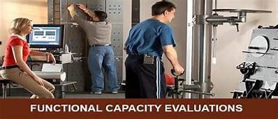
Functional Capacity
 Functional capacity is required only to determine the quantity and type of RLUs you will need to meet the project scope.
For example, a Sun StorEdge™ T3 array might contain 36 gigabyte or 73 gigabyte drives. A fully configured rack of Sun StoreEdge T3 arrays with 36 gigabyte drives has a functional capacity of 2.5 terabyte. A fully configured rack of Sun StoreEdge T3 arrays with 73 gigabyte drives has 5.2 terabyte functional capacity.
So, if your project scope specifies 100 terabytes of storage, you would need only 20 Sun StoreEdge T3 arrays with 73 gigabyte drives. Forty would be needed if 36 gigabyte drives are used.
35

Slide 13
5. Site Selection
36
When housing a data center in an existing building, several design issues must be considered to choose the best location. Careful planning is essential to assure that a location will meet not only immediate needs, but future needs as well
“Geographic Location”
“Data Center Site Selection”

Slide 14
Geographic Location
37
Choosing a geographic location for the data center could mean many things. Potential problems in the geographic location might not be obvious. Resource availability and potential problems, whether natural or man-made, are critical issues and uncovering them requires careful research.
Natural Hazards
Man-Made Hazards
Flooding
Seismic Activity
Industrial Pollution (Factories , Manufacturing facilities , Sewage treatment plants , Farms )
Electromagnetic Interference
Vibration
Tornados and Hurricanes
High Winds
Temperature Extremes
Fire

Slide 15
Data Center Site Selection
38
The location of the center must be based on numerous criteria, including those discussed in the following sections.
Retrofitting an Existing Site
Security
Access
Raised Flooring
Isolation From Contaminants
Risk of Leaks
Environmental Controls
Room for Expansion

Slide 16
Security
39
Not all businesses have a need for high-level security, but most businesses must make sure their data centers are secure from vandalism, industrial espionage, and sabotage.
A separate control room and remote access to the systems to minimize the
traffic through the data center.
Locate the data center inside the existing building so there are no exterior windows or doors.
Avoid sites with windows leading to uncontrolled areas.
Design the area to limit and control access.
Make sure the design includes surveillance cameras, motion detectors, and alarms.
In situations where you must share data center space with other companies,
an effective means of segregating the space should be considered.
Make sure the design includes fast-acting fire control such as FM200.

Slide 17
Isolation From Contaminants
40
Isolate the data center from contaminants or contaminant-producing activities. Avoid locating the center near print rooms, machine shops, wood shops, loading docks, and areas that involve the use of chemicals or generate toxic vapors or dust.
Make sure the exhaust from generators or other sources of exhaust do not enter the intakes of air handlers serving the data center. If the data center must be located near these hazardous locations, adequate filtering systems must be added to the design. Also, maintenance schedules for the filtering system should be more frequent.

Slide 18
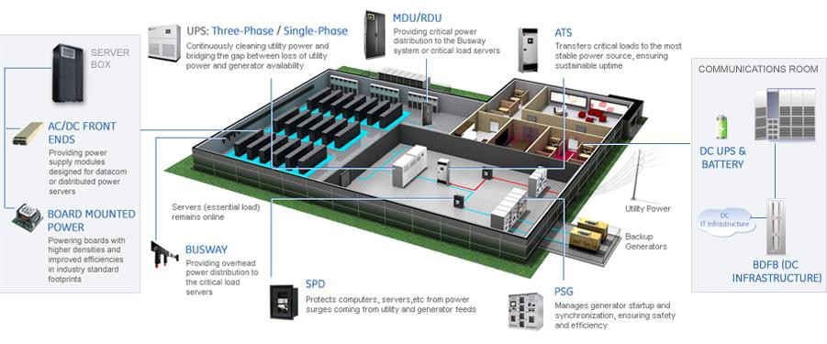
6. Power Distribution System Design
41
well-designed electrical system for the data center ensures adequate and consistent power to the computer hardware and reduces the risk of failures at every point in the system. The system should include dedicated electrical distribution panels and enough redundancy to guarantee constant uptime
Assessing PowerRequirements
Multiple Utility Feeds
Uninterruptible PowerSupply
Backup PowerGenerators
SharingBreakers
MaintenanceBypass
Installation andPlacement

Slide 19
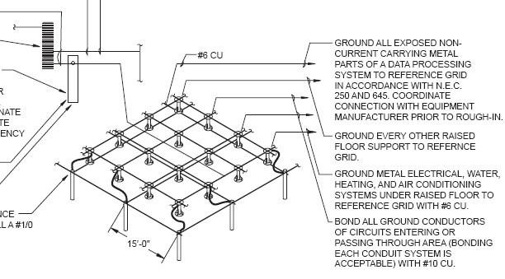
Grounding and Bonding
42
Grounding is the creation of a path to an electrically conductive body, such as the earth, which maintains a zero potential (not positively or negatively charged) for connecting to an electrical circuit.
A Signal Reference Grid (SRG) is a means to reduce high- frequency impedance (also called noise) so that a device or outlet has the lowest impedance path to earth ground. This grid has multiple paths to ground to ensure that grounding loops do not develop.

Slide 20
Wiring and Cabling
43
All wiring and cabling should be designed and installed in accordance with NFPA 70 of the National Electrical Code, or superseding national or local codes. All wiring and cabling should be run in an orderly and efficient manner, not like the “spaghetti”
Higher Amps and Single-Phase or Three-Phase
Power Distribution Units (PDU)

Slide 21
Electromagnetic Compatibility
 Electromagnetic interference (EMI) and radio frequency interference (RFI) is radiated and conducted energy from electrical devices that produce electromagnetic fields. The electrical noise currents associated with these can interfere with the signals carried by the electronic components and the cabling of equipment.
Sources of EMI and RFI can be inside or outside the data center environment. Common external sources are airports, telecommunications or satellite centers, and similar facilities. Internal sources include the hardware itself. Sun equipment is tolerant of most common EMI/RFI levels. If high levels are suspected, a study should be conducted to determine whether shielding or other remedial actions are necessary.
44

Slide 22
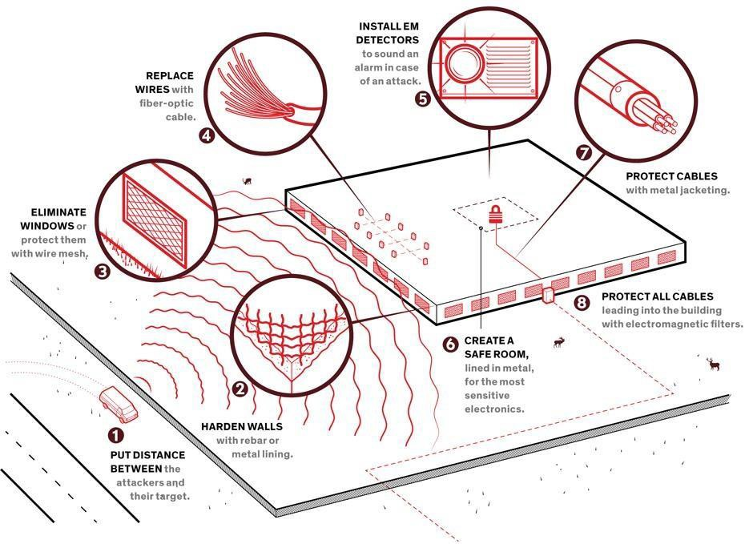
45

Slide 23
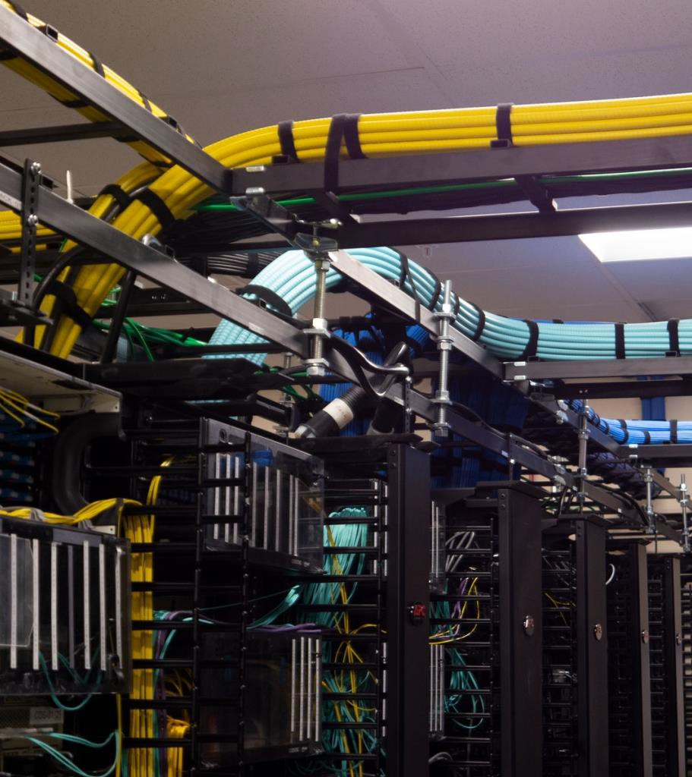
7. Network Cabling Infrastructure
46

Slide 24
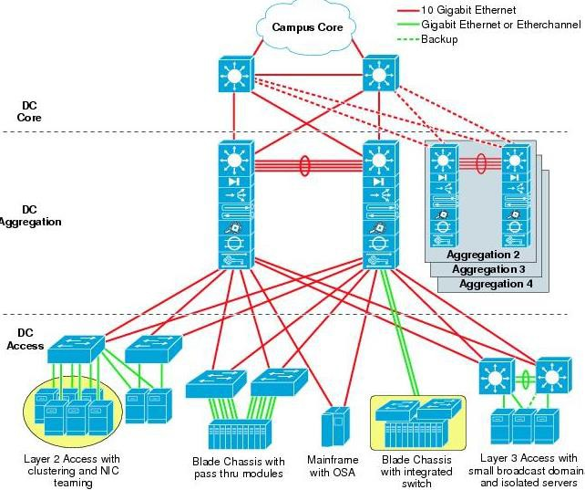
“Creating a Network Cabling Infrastructure”
 Determining Connectivity Requirements
 Modular Design
 Hierarchy of the Network Structure
47

Slide 25
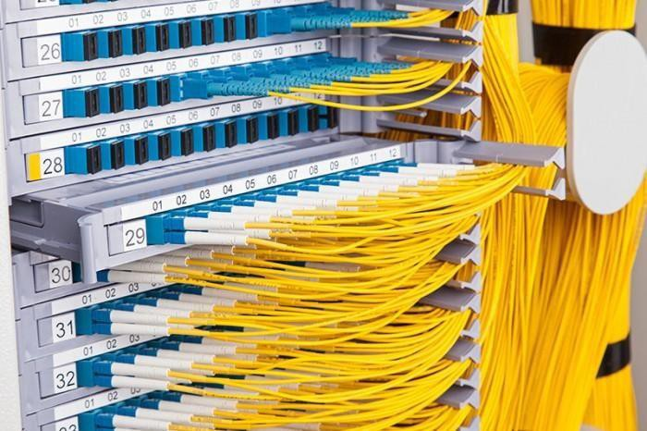
Points of Distribution
48
A Point Of Distribution (POD) is a rack of devices and patches that manages a certain number of RLUs (which you can think of as a group of devices). PODs allow you to distribute both the physical and logical networking cables and networking equipment into modular and more manageable groups, and allow you to centralize any necessary cross-patching. All of the cabling from a group of devices can connect to the network through the POD.
The POD rack contains three things:
Network Terminal Servers (NTS)
Cat6 and fibre ports for cross-patching
Network sub-switches

Slide 26
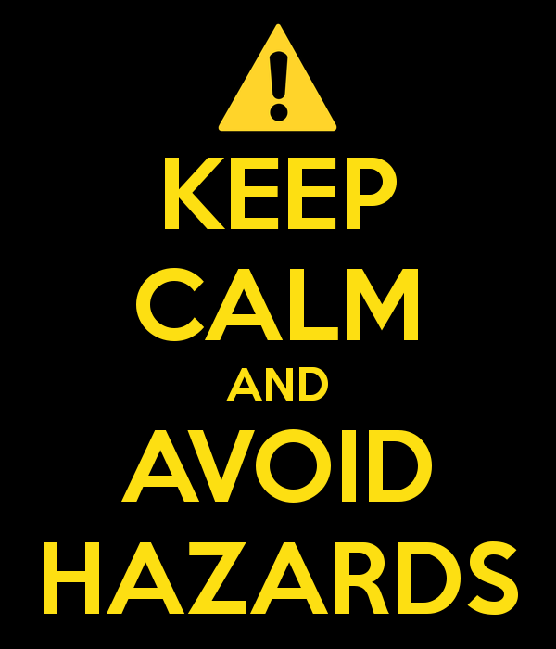
8. Avoiding Hazards
 Potential hazards in a data center can range from mildly inconvenient to devastating. Some are difficult to avoid, but knowing what the potential hazards are in the data center area is the first step in preparing to avoid or combat them.
49

Slide 27
Potential hazards in a data center can range from mildly inconvenient to devastating. Some are difficult to avoid, but knowing what the potential hazards are in the data center area is the first step in preparing to avoid or combat them.
Avoiding Hazards
There are two type of Hazards as following:
Some natural hazards are:
Fire from electrical storms
Flooding from rain, overflows, runoff
Earthquakes
High winds
Hurricanes
Tornados
Some human-created hazards are:
Fire from electrical short circuits
Flooding from equipment failure, leaking
plumbing, sprinkler systems
Vibration caused by construction, large equipment, nearby industry
Noise from data center computers, large
machinery, nearby industry

Slide 28
Personnel Health and Safety
51
From the very earliest design phases of the data center, the most important concern in disaster avoidance and recovery is for human health and safety. Equipment is important, but it always comes second to people.
Keep room personnel to the absolute minimum
Authorized personnel should be trained to respond to emergency situations
Monitor air quality in the room
Ensure that personnel are able to exit the room or building efficiently
Avoid blockages and doors that won’t open easily from the inside
Avoid long rows of racks or equipment with no breaks

Slide 29
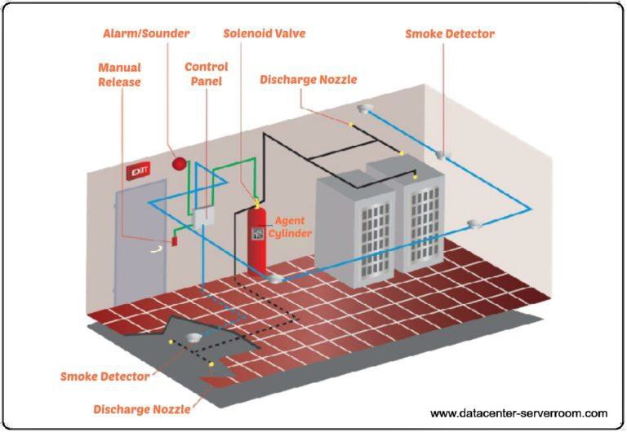
9. Fire Suppression Systems
 Modern gas systems are friendlier to hardware and, if the fire is stopped before it can do any serious damage, the data center might be able to continue operations.
 Water sprinklers are sometimes a viable alternative if saving the building is more important than saving the equipment (a water system will probably cause irreparable damage to the hardware).
 Gas systems are effective, but are also shorter lived.
Once the gas is discharged, there is no second chance, whereas a water system can continue until the fire is out. Water systems are highly recommended in areas that contain a lot of combustible materials such as storerooms.
 FM200
 Dry pipe sprinkler
 Wet pipe sprinkler
 Halon 1301.Not recommended
 Carbon dioxide. Not recommended
52

Slide 30
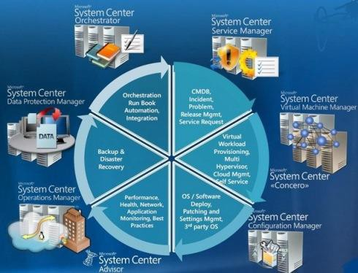
10. Managing System Configurations
53
In the world of systems management, it seems that there is always something that needs to be done. An important aspect of systems management is managing the system configurations. Managing the configuration includes managing the version and revision levels of system and application software, the types and versions of systems and adapters, the networks that the system is attached to, and the storage subsystems and their attachment mechanism, and all software, hardware, and firmware patches for all of the above. While this can seem to be a daunting task, particularly in large, fast-growing, complex environments, the configuration can be managed.

